Slide 1
ONLINE VOTING SYSTEM USING FACIAL RECOGNITION
Under the Guidance of : Dr. K. AMBEDKAR
Done By :
KAMUJU NOVA (19R11A0517)
VANKAYALAPATI VINITHA (19R11A0544)
VUDHANTHI NEERAJA (19R11A0548)

Slide 2
CONTENTS
Abstract
Existing System And Proposed System
System Configuration
System Architecture
Modules
Advantages and Disadvantages
UML Diagrams
Templates
Conclusion

Slide 3
Abstract
Not only providing a proper authenticated electoral card but also the proper verification is also needed in order to allow the voter to cast his/her vote.
The present form of verification to vote is:
The basis of verification of the is the manual check of the photo that is provided on the voter ID and on the electoral card that is issued.
The are major problem that is encountered:
The details and evidences can be counterfeited and illegitimate identity can be created.
These fake identities are then used in vote rigging which paves way for an undeserving party to win.
In order to tackle this issue, in our proposed system, we have made use of Facial Recognition to verify the user identity on the election day.

Slide 4


Existing System
The present used process to verify the identity of the voter is done manually.
The verification is done twice i.e. once before issuing the voter card along with the electoral card and again on the day of the election.
Before the process of verification is done, the details are collected from the user. This collection of data is either done through online or through filling a physical form.

Slide 5
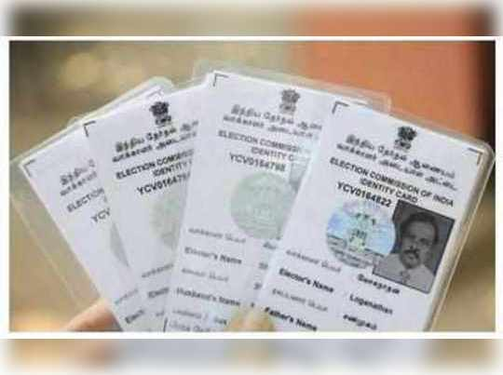
The details which are collected for the verification process are:
Address proof (Passport, Aadhaar Card or Water bill etc)
Copy of proof of age (10th certificate, driving licence etc)
Identity proof (Bank passbook with photograph, passport etc)
Recent passport size photographs.
To verify these documents, an official from the election commission visits the voters residence and verifies the address and identity in person.
During this process of verification, if any discrepancies are found the application is rejected or else if the details are proven to be satisfactory the Voter ID is issued.

Slide 6
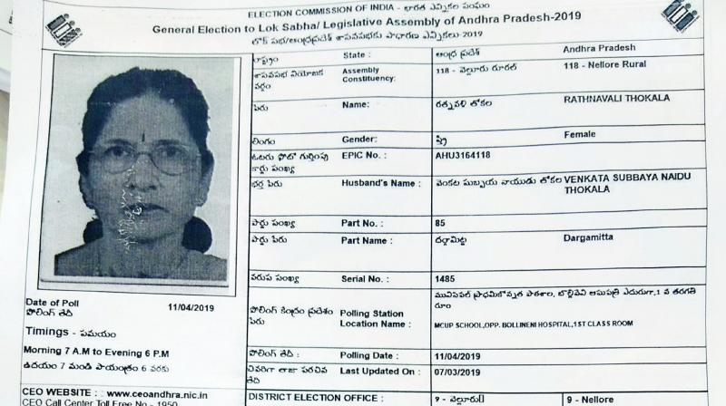
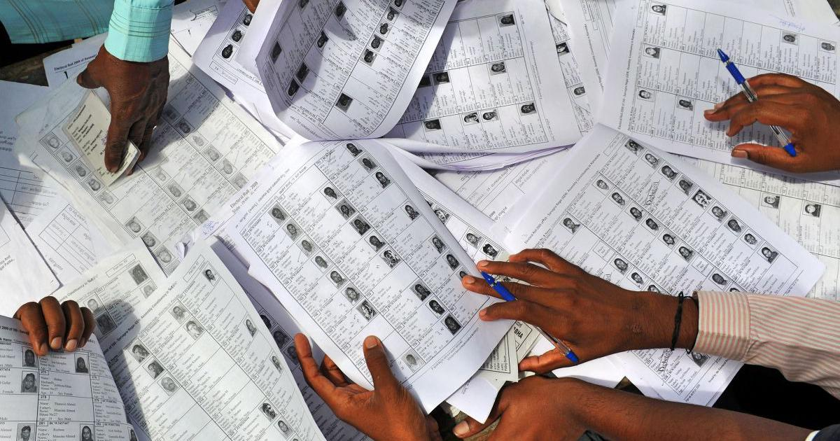
After the Voter ID is verified few days before election day, the electoral are issued electoral cards/ slips which permits the voter to enter the booth allotted to them.
These issued slips are verified by an election booth officer based on the details provided by the user as part of the application process and Voter ID.
Along with these details, the user’s identity is verified based on the photo on the Voter ID and the slip that is issued to them.
These details are matched with the electoral sheet which is also provided to the election booth officer by the government.

Slide 7
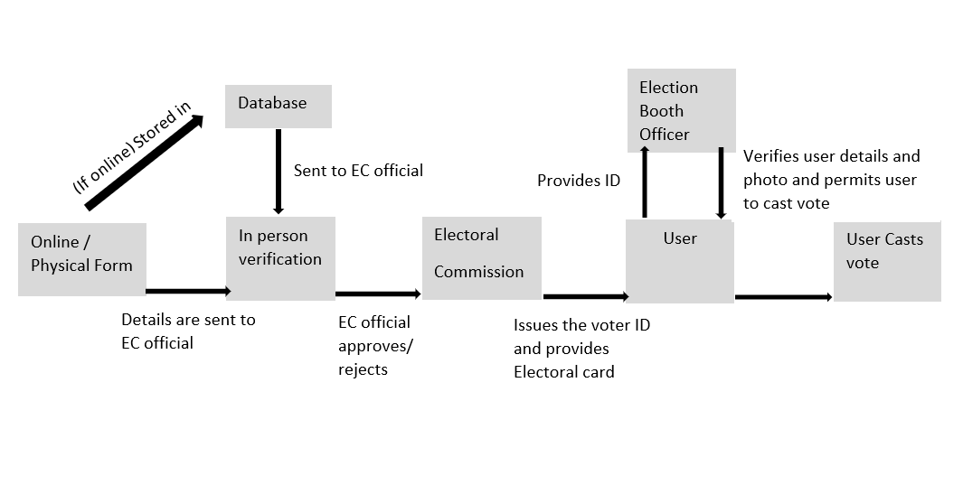
Existing system architecture

Slide 8
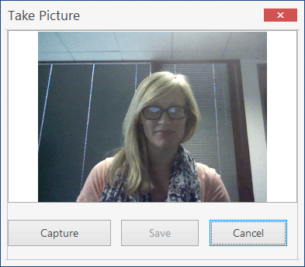

Proposed System
Initially the online/ physical application if filled by the voter and a live image is captured of the voter during the submission of the application.
The captured image of the voter is now stored in the database along with the documents that are submitted by the voter.

Slide 9

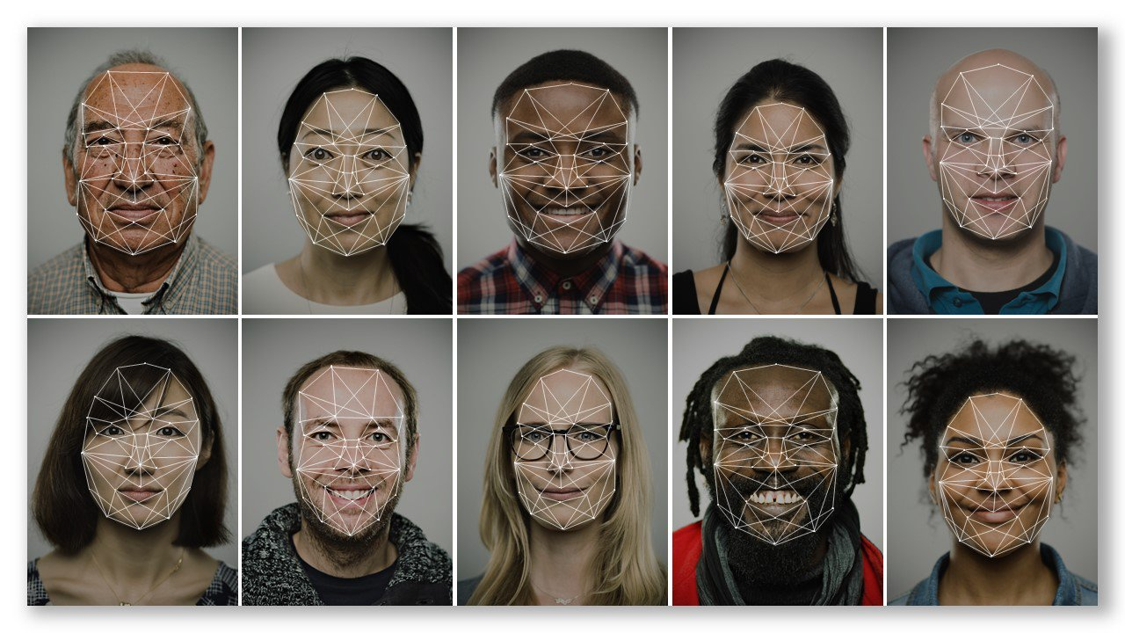
The Voter Identity Verification System, makes use of the facial recognition.
When the booth officer has to check for the lineaments of the voter must be very accurate.
But with the use of the facial recognition, even if there might be changes in the appearance, the facial alignments of the voter will always be constant and it will be made easy for the officer to legitimize the voter.
The images and labelled names from the database are used for training the facial recognition model.

Slide 10
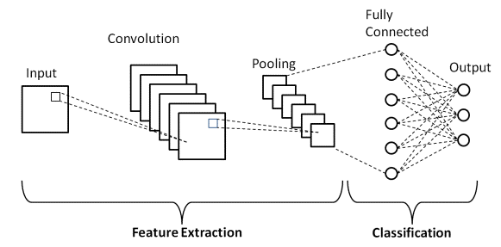

The algorithms used in facial recognition are:
CNN (Convolutional Neural Network)
SVM
Eigenfaces
CNN:
A type of machine learning in which a model learns to perform classification tasks directly on an image, video. CNN is a normal neural network with new layers — convolutional and pooling.
SVM:
The goal of the SVM algorithm is to create the best line or decision boundary that can segregate n-dimensional space into classes so that we can easily put the new data point in the correct category in the future. This best decision boundary is called a hyperplane.SVM chooses the extreme points/vectors that help in creating the hyperplane. These extreme cases are called as support vectors, and hence algorithm is termed as Support Vector Machine.
Eigenfaces:
Eigenfaces is a face detection and recognition method that determines face variance in image data sets. Facial features are assigned mathematical values, as this method doesn’t use digital pictures but rather statistics. Any human face is a combination of these values with different percentages.
These algorithms are directly implemented using the face_recognition library that is readily available in python.

Slide 11
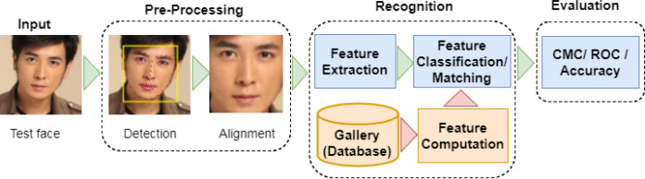

Slide 12
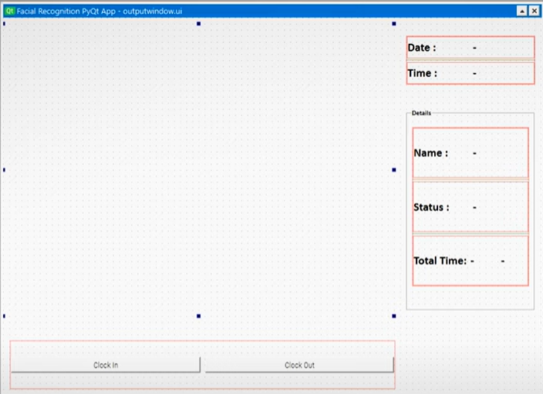
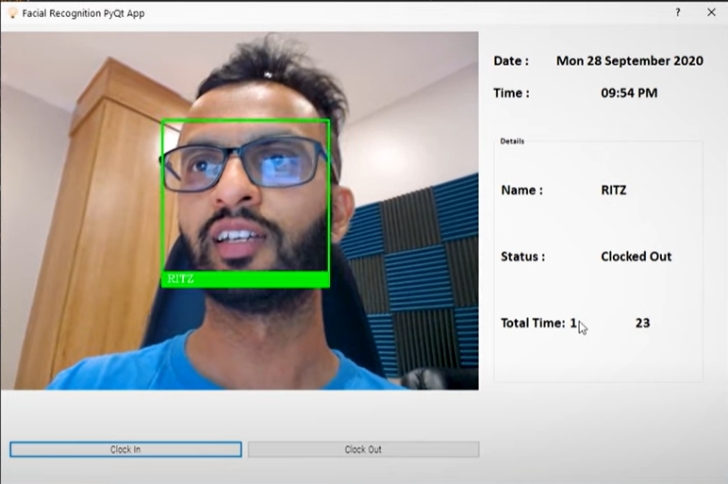

The model takes the voters face input image.
Matches it with the face image available in the data.
Checks for the vote attribute that indicates whether a person has voted or not.
If the voter has not voted, the system changes the status of the voter to “voted” and permit the voter to vote.
Else if the voter seems to have voted previously and is trying to rig their vote, the voters will be restricted to vote.
NOT VOTED
VOTED

Slide 13
System Configuration
Software Requirements
Operating system : MICROSOFT/MAC
Databases (for User information) : MySQL
OpenCV
Python IDE : PyCharm/ VSCode/ Sublime Text
Programming languages : HTML,CSS,Javascript
Framework : StreamLit
Hardware Requirements
Camera : Web camera
CPU : Intel Core 2 Quad Processor
RAM : 8 GB

Slide 14
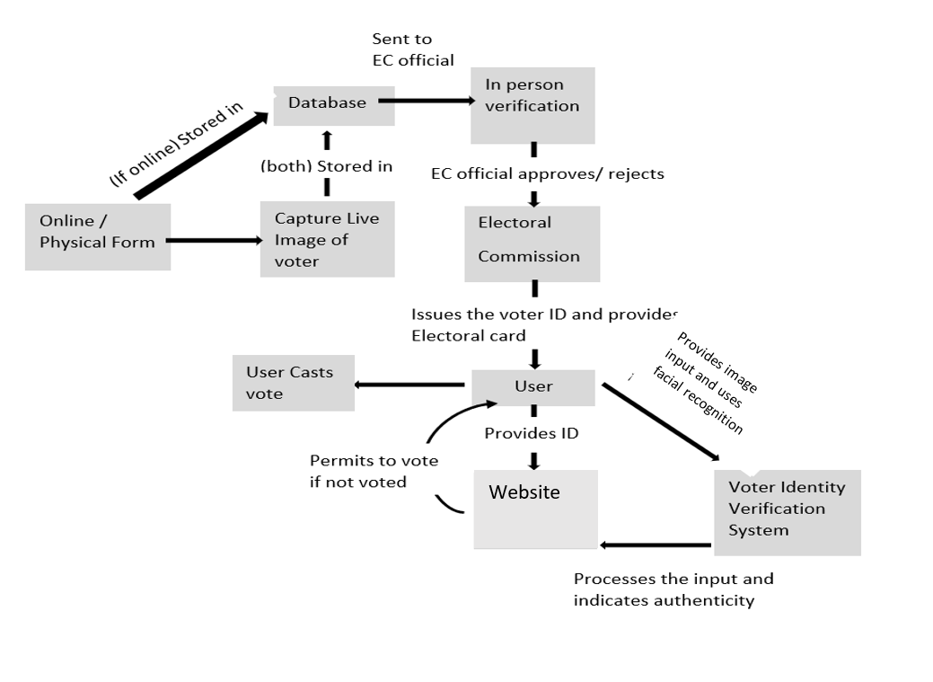
System Architecture

Slide 15
Modules
User :
The voter inputs the image of themselves.
Voter Verification System (VVS):
The VVS takes in the input from the camera and matches the face with the user photo in the database using Facial Recognition.
Authenticates the voter and signals the election booth officer whether the voter has previously voted or not.
PC :
The tasks that are to be performed are done on the PC.

Slide 16
Advantages
We use CNN and eigenfaces algorithm capable of finding over 99% of the faces in database and allows the voter to vote in approximately 1-2 minutes.
This system allows only authenticated voting than the existing equipment as the person is identified based on his Facial recognition which is unique to each individual.
Less manpower required.
Avoids invalid voting as it prevents unregistered voters from voting.

Slide 17
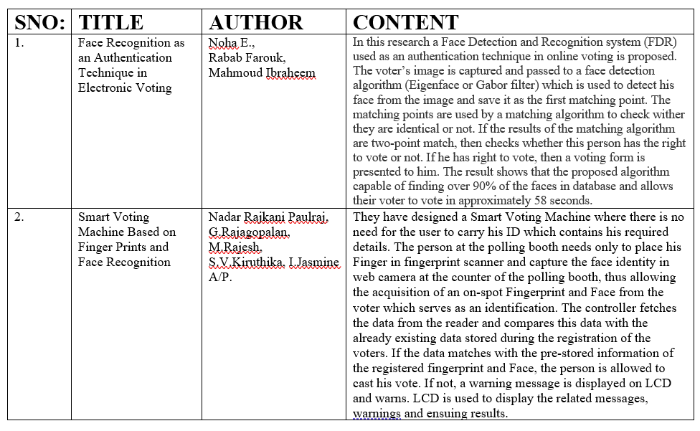
Literature Survey

Slide 18
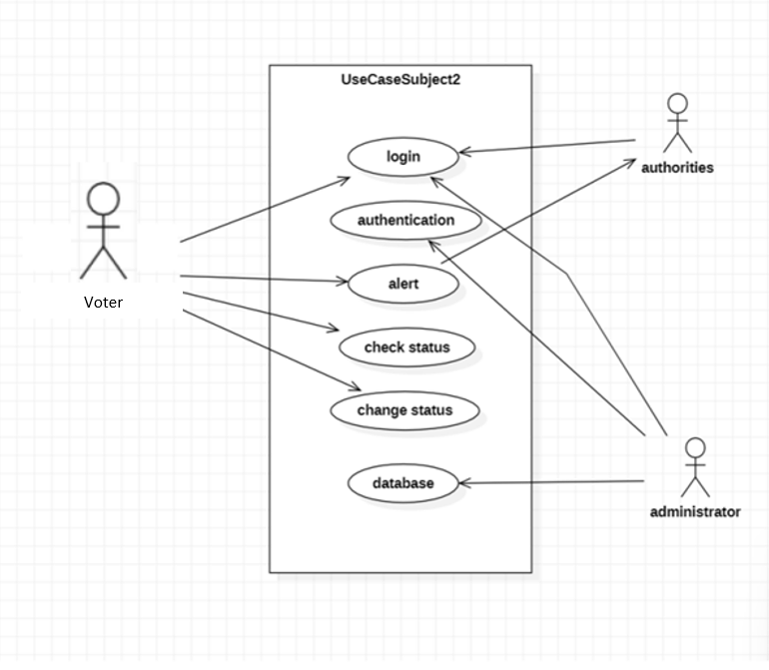
UML Diagrams Usecase diagram

Slide 19
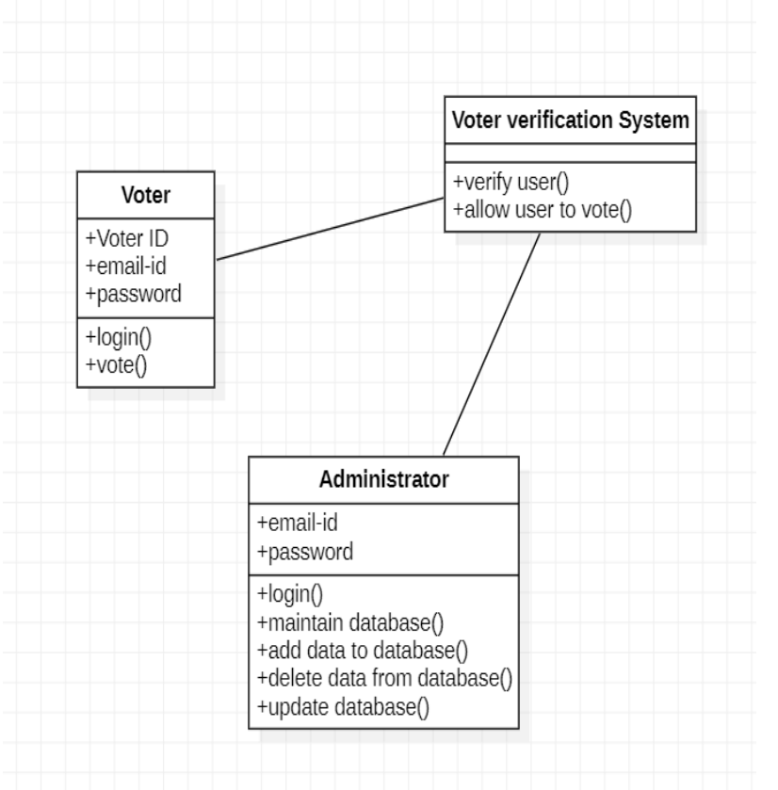
Class diagram

Slide 20
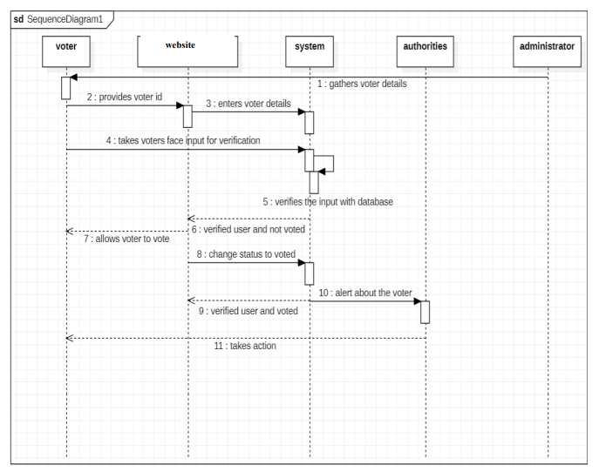
Sequence diagram

Slide 21
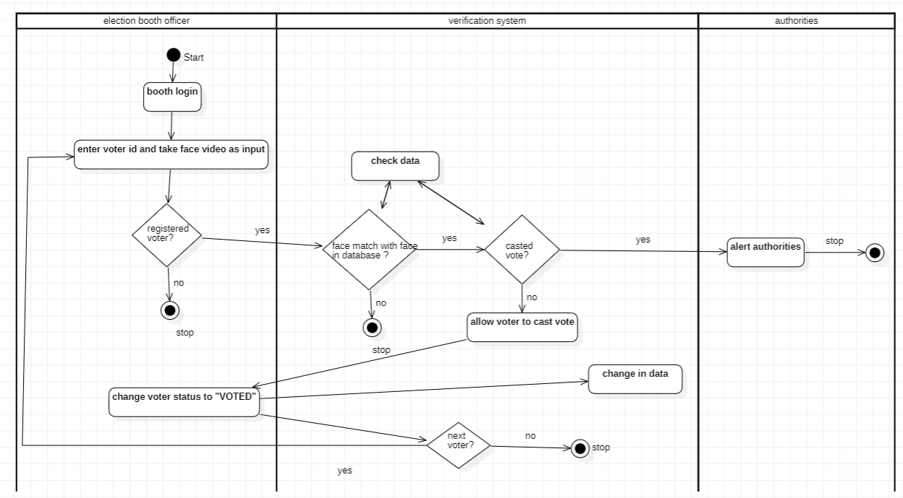
Activity Diagram

Slide 22
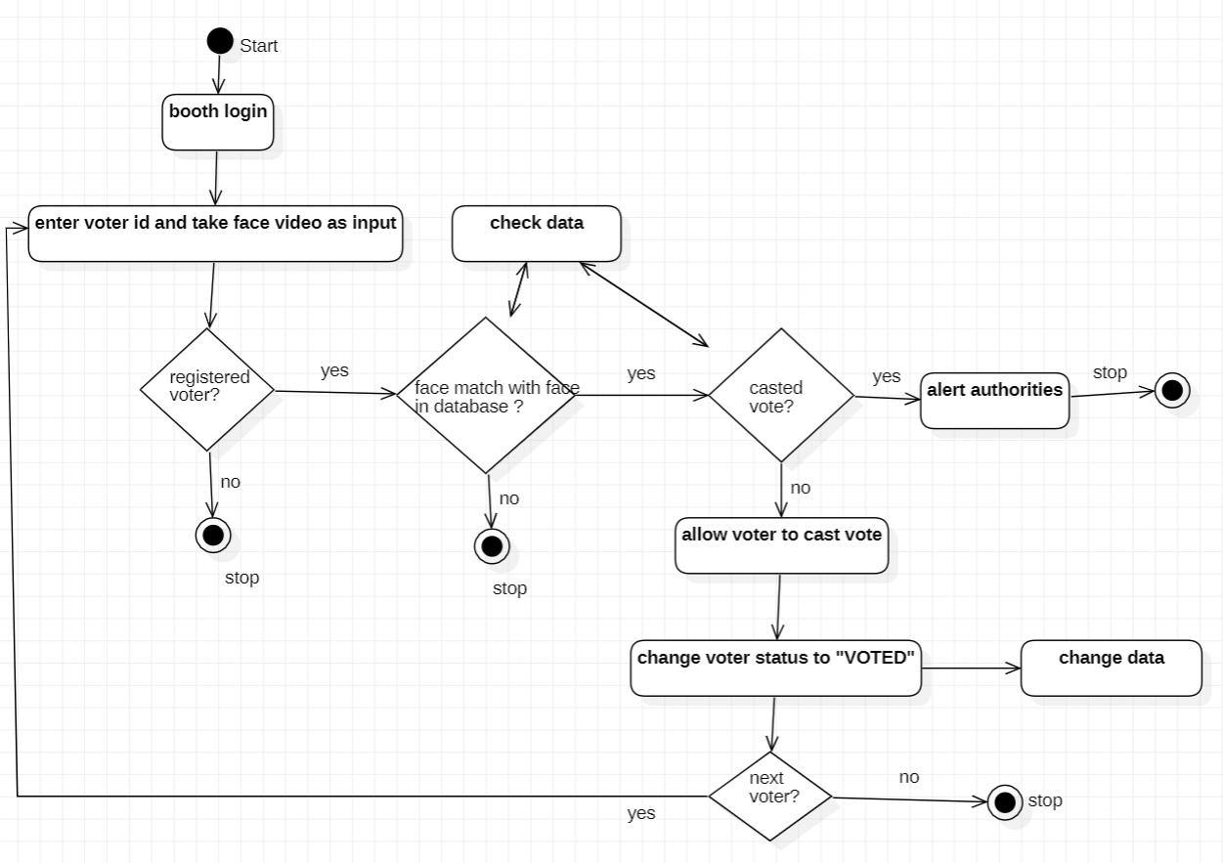
Statechart Diagram

Slide 23
Data flow diagram

Slide 24
The algorithms used in facial recognition are:
CNN (Convolutional Neural Network)
SVM
Eigenfaces
CNN:
A type of machine learning in which a model learns to perform classification tasks directly on an image, video. CNN is a normal neural network with new layers — convolutional and pooling.
SVM:
The goal of the SVM algorithm is to create the best line or decision boundary that can segregate n-dimensional space into classes so that we can easily put the new data point in the correct category in the future. This best decision boundary is called a hyperplane.SVM chooses the extreme points/vectors that help in creating the hyperplane. These extreme cases are called as support vectors, and hence algorithm is termed as Support Vector Machine.
Eigenfaces:
Eigenfaces is a face detection and recognition method that determines face variance in image data sets. Facial features are assigned mathematical values, as this method doesn’t use digital pictures but rather statistics. Any human face is a combination of these values with different percentages.
These algorithms are directly implemented using the face_recognition library that is readily available in python.

Slide 25
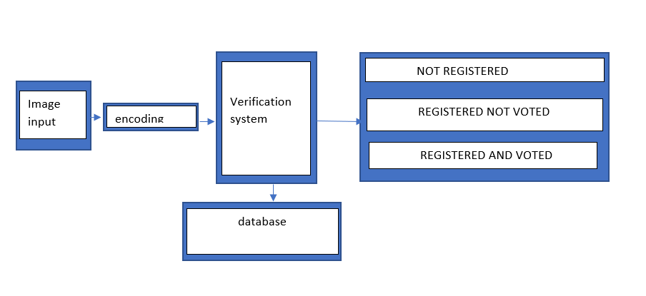
Data during implementation

Slide 26
FOR MYSQL CONNECTION:
import mysql.connector
db = mysql.connector.connect(
host="localhost",
user='root',
passwd='1236',
database='testdatabase’
)
ENCODING FUNCTION:
def findEncodings(images):
encodeList = []
for img in images:
img = cv2.cvtColor(img, cv2.COLOR_BGR2RGB)
encode = face_recognition.face_encodings(img)[0]
encodeList.append(encode)
return encodeList

Slide 27
FUNCTION FOR CHECKING STATUS:
def markVoted(name):
query = """SELECT Status FROM VoteStatus WHERE Name=%s"""
tuple1 = name
mycursor.execute(query,(tuple1,))
status = mycursor.fetchone()
#print(status)
if status[0] == 'notvoted':
query = """UPDATE VoteStatus SET Status = 'voted' where Name=%s"""
tuple1 = name
mycursor.execute(query, (tuple1,))
db.commit()
return status[0]

Slide 28
FUNCTION FOR CHECKING THE NUMBER OF TIMES VOTED:
def getVoteCount(name):
query = """SELECT Count FROM VoteStatus WHERE Name=%s"""
tuple1 = name
mycursor.execute(query, (tuple1,))
votes = mycursor.fetchone();
#print(votes)
if votes[0] == 0:
query = """UPDATE VoteStatus SET Count = 1 where Name=%s"""
tuple1 = name
mycursor.execute(query, (tuple1,))
db.commit()
return votes[0]

Slide 29
ENCODING THE FACE FROM THE INPUT:
cap = cv2.VideoCapture(0)
i= 0
name = 'not registered'
while i!=1:
success, img = cap.read()
imgS = cv2.resize(img,(0,0),None, 0.25,0.25)
imgS = cv2.cvtColor(imgS, cv2.COLOR_BGR2RGB)
facesCurFrame = face_recognition.face_locations(imgS)
encodesCurFrame = face_recognition.face_encodings(imgS,facesCurFrame)
for encodeFace, faceLoc in zip(encodesCurFrame, facesCurFrame):
matches = face_recognition.compare_faces(encodeListKnown,encodeFace)
faceDis = face_recognition.face_distance(encodeListKnown,encodeFace)
# print(faceDis)
matchIndex = np.argmin(faceDis)
if matches[matchIndex]:
name = classNames[matchIndex]
print(name)
i+=1
cap.release()
cv2.destroyAllWindows

Slide 30
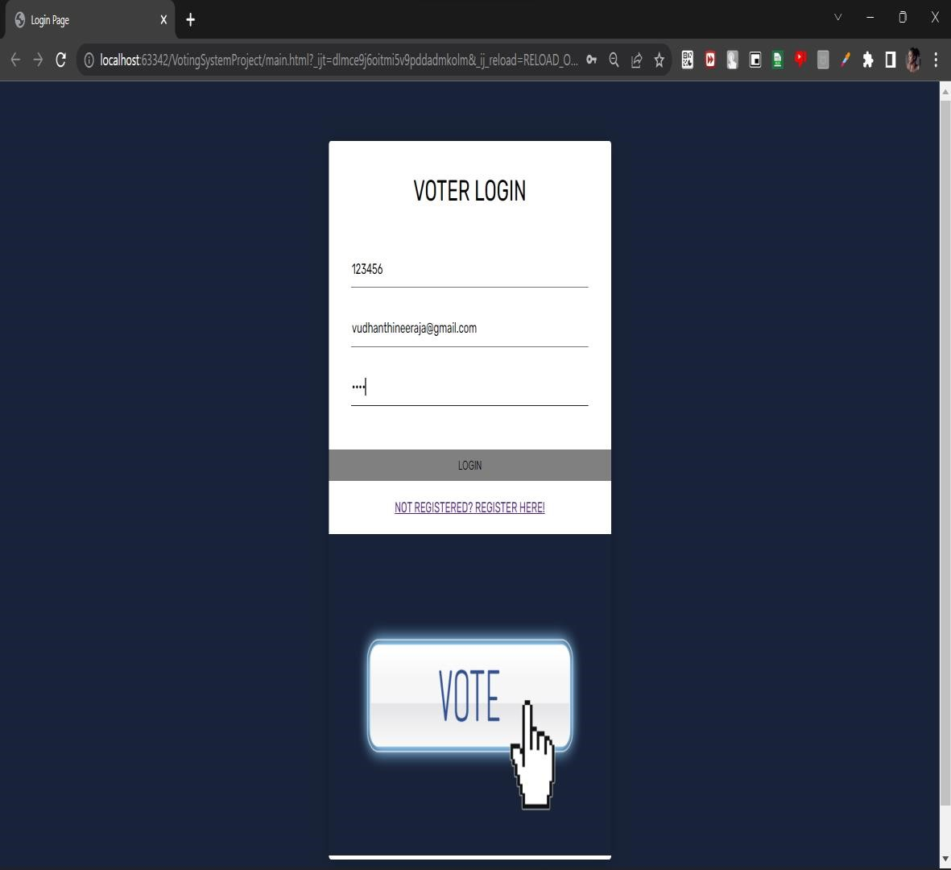
Implementation
LOGIN SCREEN

Slide 31
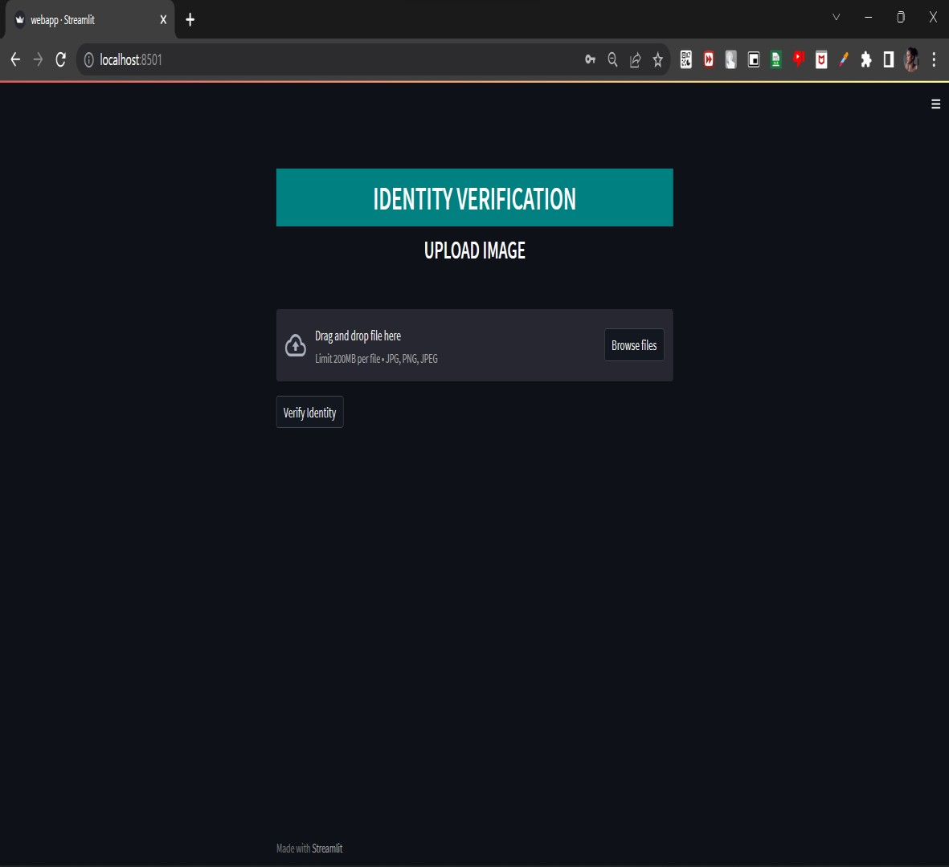
Identity Verification screen where image is uploaded

Slide 32
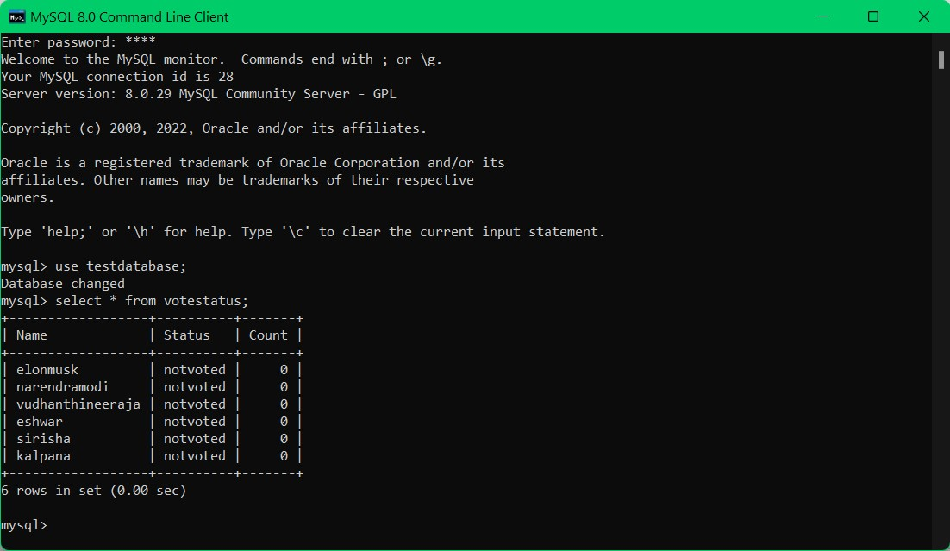
The database before the voter has voted

Slide 33
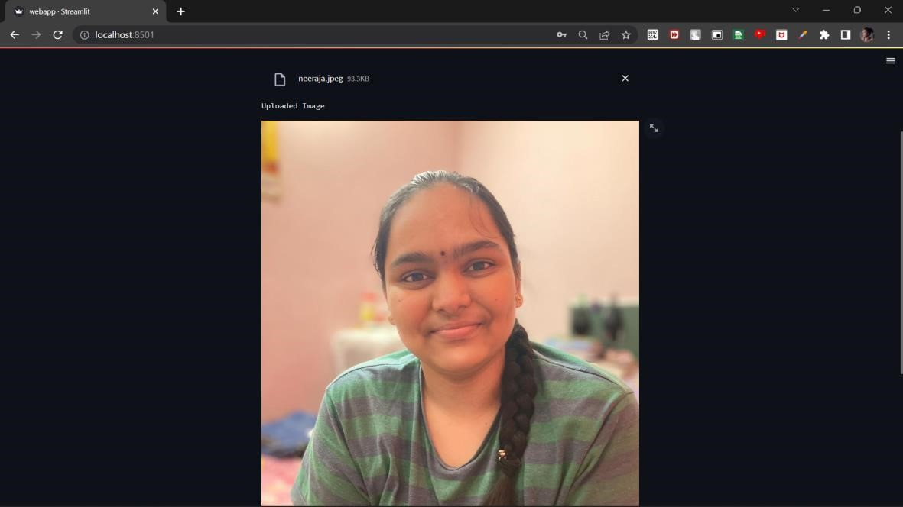
Identity Verification screen after image is uploaded

Slide 34
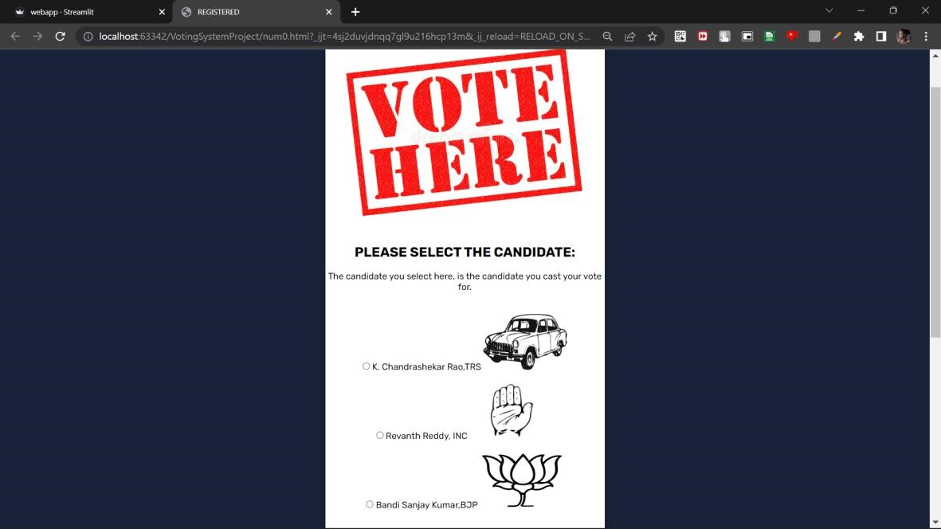
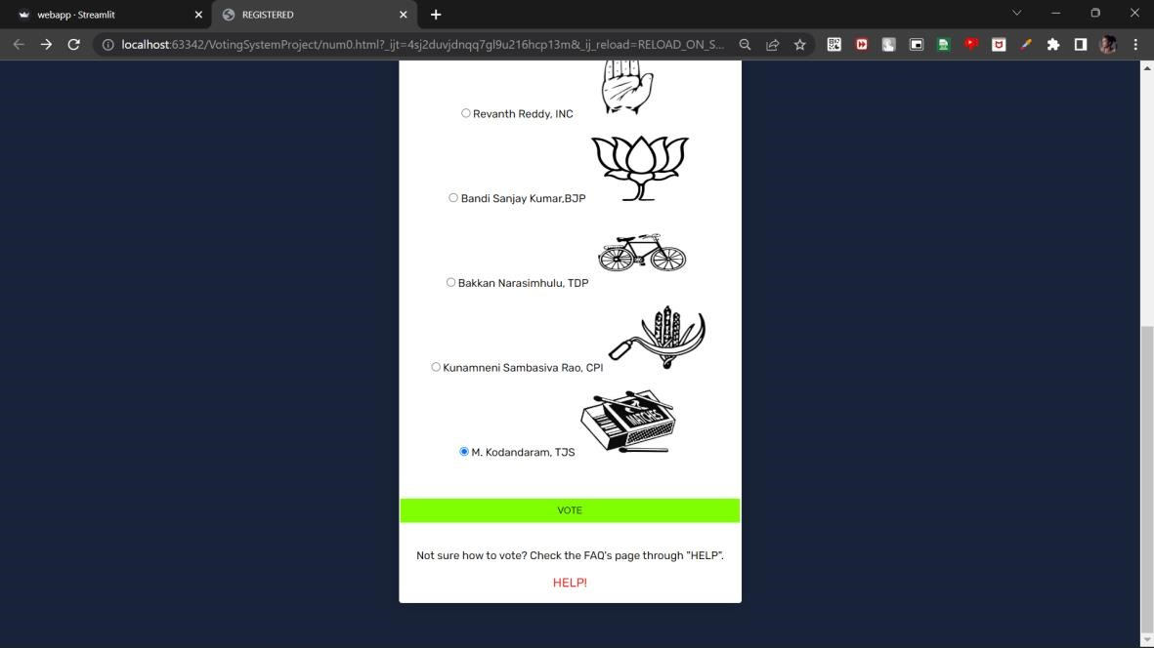
Voting Screen after the voter has been verified.

Slide 35
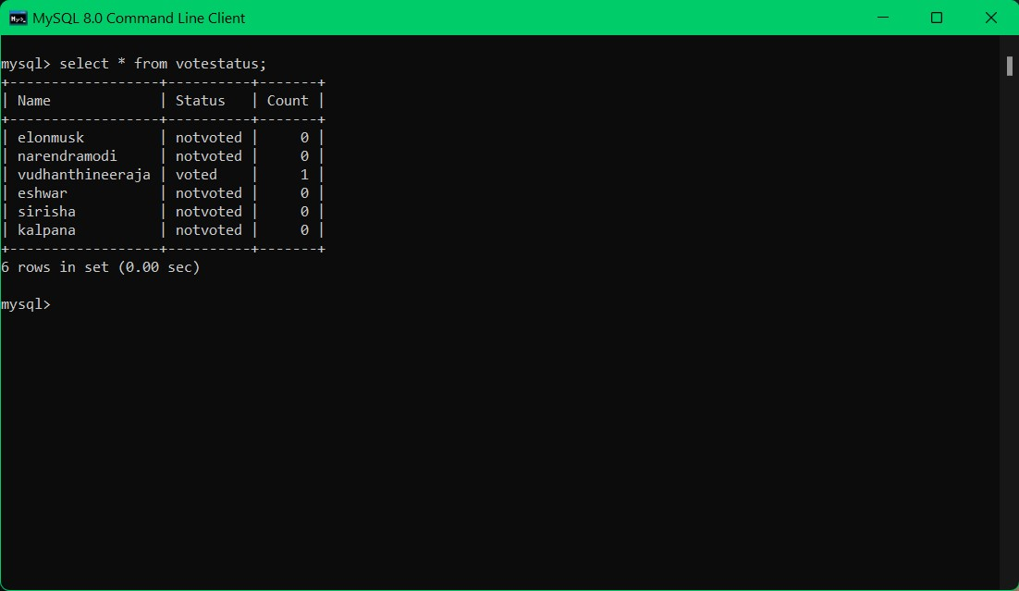
The database after the voter has voted

Slide 36
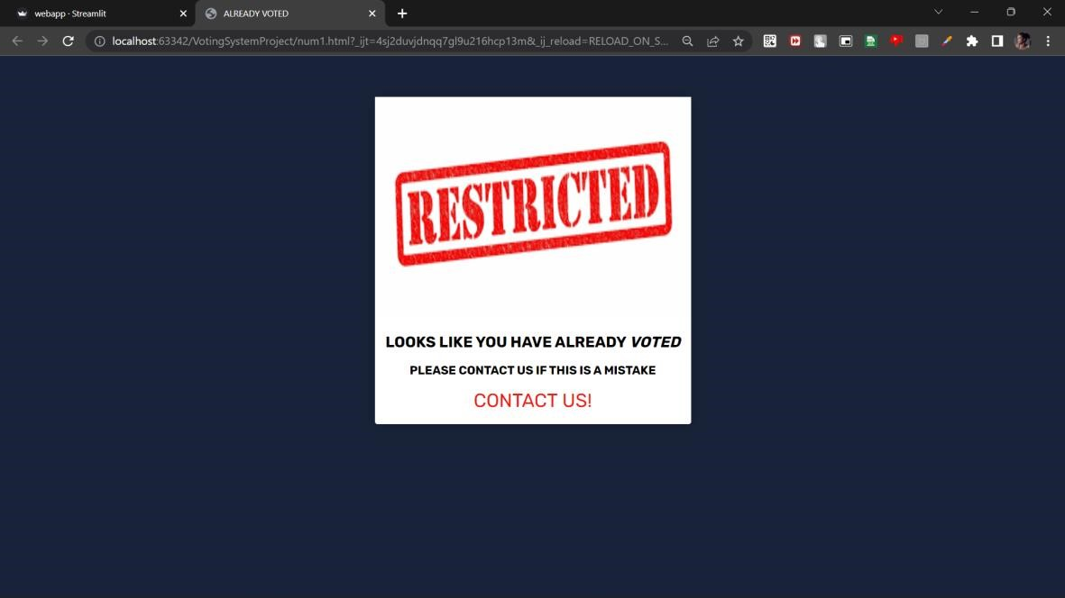
Restricted output screen to restrict voter to vote again.

Slide 37
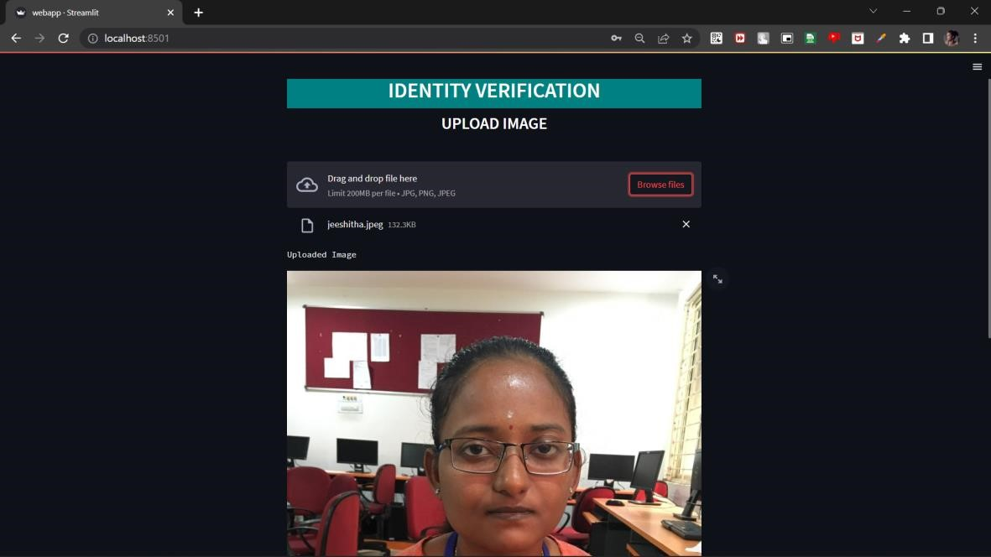
Identity Verification screen after non registered voter image is uploaded

Slide 38
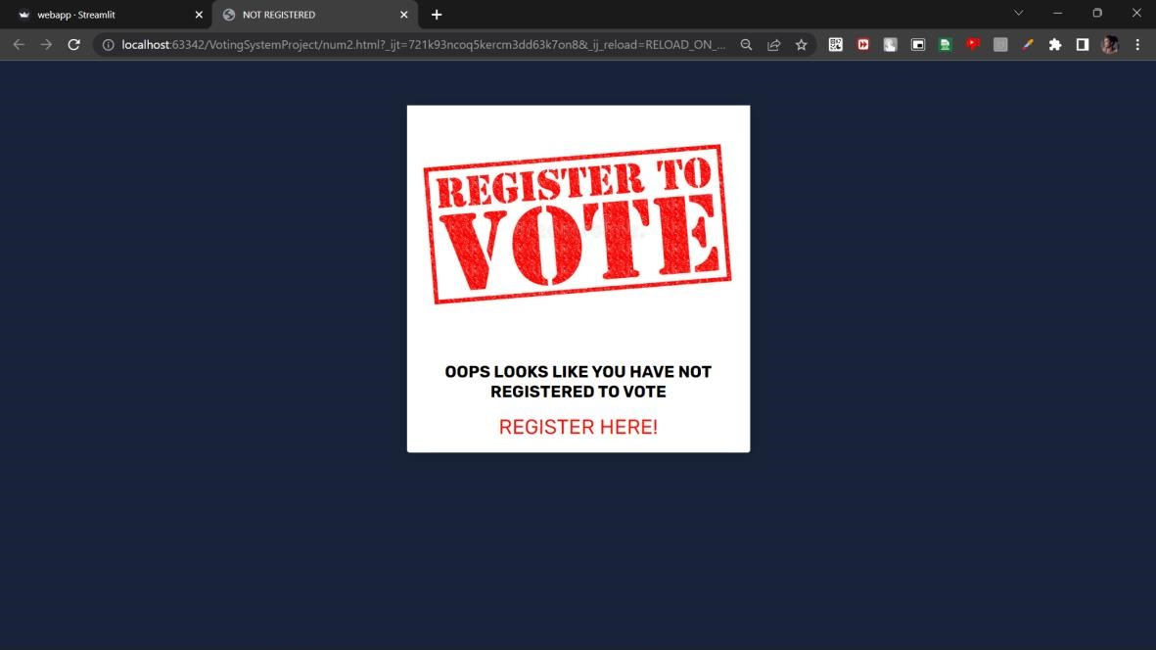
Output page to allow non registered voters to registers

Slide 39
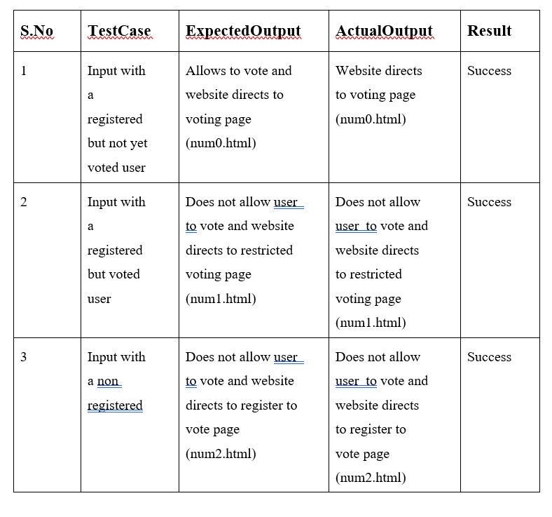
Test Cases

Slide 40
Future Work
Electronic voting and online voting systems, to be successful, requires a more transparent and secure approach, than is offered by current protocols. The future enhancements involves a protocol developed on blockchain technology. The underlying technology used in the voting system is a payment scheme, which offers anonymity of transactions, a trait not seen in security protocols used for online and electronic systems to date. The block chain protocol when integrated to the online voting system offers anonymity of voter transactions, while keeping the transactions private, and the election transparent and secure.

Slide 41
Conclusion
Online Voting Systems easy accessibility, accuracy, and low risk of human and mechanical errors.
This Online Voting system will manage the Voter's information by which voter can login and use his voting rights.
Vote counting is also made easy by the OVS since it's just a matter of querying the database.
The proposed system validates the user using the facial recognition and allows the user to vote if he’s a first time user, restricts the user if he’s trying vote again and prompts user if they are not registered.

Slide 42
THANK YOU

